Slide 1
Web Development 3
Lecture 7 – AJAX
Asynchronous JavaScript and XML
Lecturer: James Byrne (jamesbyrne@ait.ie)

Slide 2

Topics
What is Ajax?
History of development
Defining Ajax
Ajax Ingredients
Data Formats
JSON parsing
REST APIs
Ajax Toolkits vs Fetch API

Slide 3
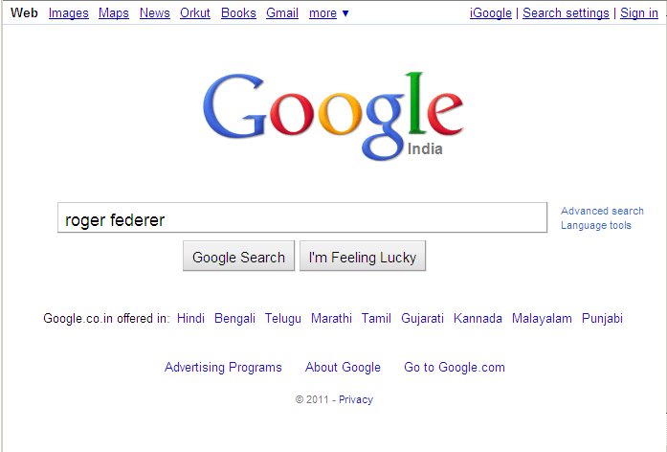
What is AJAX?
Back then

Slide 4
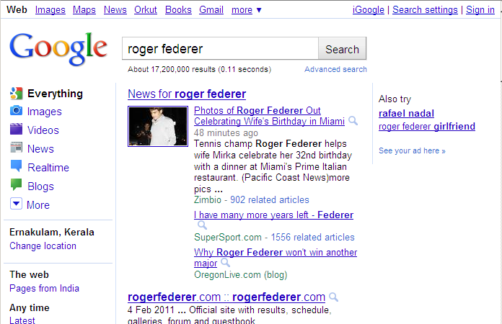
What is AJAX?

Slide 5
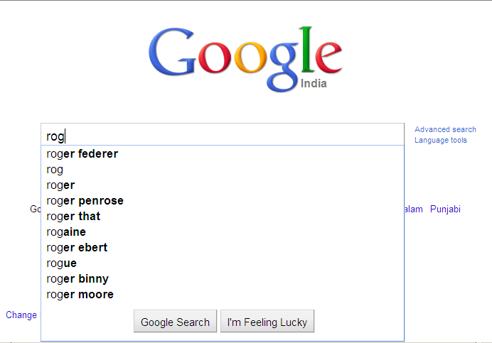
What is AJAX?
Nowadays

Slide 6
What is AJAX?
A programming language – no…
A new technology – not exactly…
So what else ?
☺ It is a methodology on using several web technologies together, in an effort to close the gap between the usability and interactivity of a desktop application and the ever demanding web application ☺

Slide 7
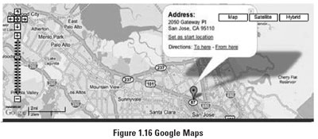

History
In 1999, Microsoft introduced the XMLHttpRequest object, an ActiveX control, in IE 5.
The term AJAX was coined on February 18, 2005, by Jesse James Garret in a short essay published a few days after Google released its Maps application.

Slide 8
History
Finally, in the year 2006, the W3C (World Wide Web Consortium) announces the release of the first draft which includes the specification for the object (XHR) and makes it an official web standard.
Jesse James Garrett, later updated his article, making it clear that Ajax is not an acronym.
Ajax is not in itself a new technology, but a technique that combines several long-standing Web technologies.
  Using HTML and CSS for structure and presentation
  Display and manipulate pages using the Document Object Model (DOM) and JavaScript
  Using the browsers XMLHttpRequest object to transfer data between the client and the server.

Slide 9



Defining AJAX
HTML Page
Traditional Web site: Client machine sends request to server.
The server sends back an entire page.

Slide 10

Defining AJAX
Data
Ajax model: data is transferred between the client and
Server. The server no longer has to send entire pages.

Slide 11
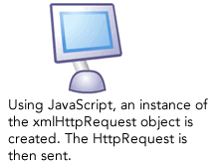
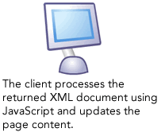

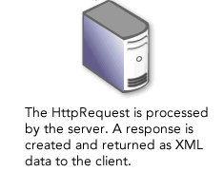
Defining AJAX
Alternatives to XML are:
JSON and HTML

Slide 12
AJAX Ingredients
XMLHttpRequest object is the engine that drives AJAX. Or the Fetch API with Promises (recent)
XML (eXtensible Markup Language). Ajax applications require some kind of structured format to deliver information from the server to the client. XML is just one option, so XML is not strictly required to build AJAX applications
Server Side The Server makes decisions about what data needs to be sent to the browser, but Ajax is language agnostic on the server. Server side can be in PHP, JAVA, Perl etc. AJAX doesn’t care nor should the client

Slide 13
AJAX Ingredients
Valid Markup Well formed markup (XHTML or HTML) is a requirement if you want to manipulate a document on the client side i.e. validates
  If the document isn’t well formed processing it becomes more complex and unpredictable
CSS (Cascading Style Sheets). Used to control presentation
DOM Scripting The DOM is a standard that describes the structure of a document

Slide 14
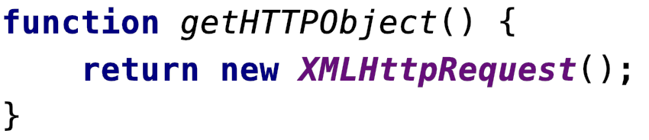
XMLHttpRequest – creating an instance
Once you have created an instance of XMLHttpRequest, it needs to be prepared for communication with the server. There are three critical components for this:
  The onreadystatechange event handler
  The open method
  The send method

Slide 15
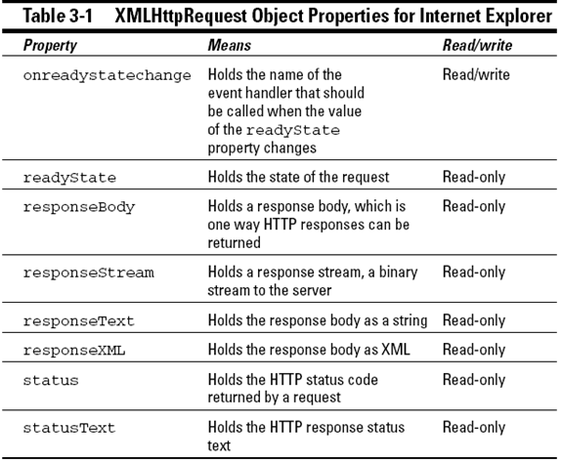

XMLHttpRequest – (XHR) Object

Slide 16
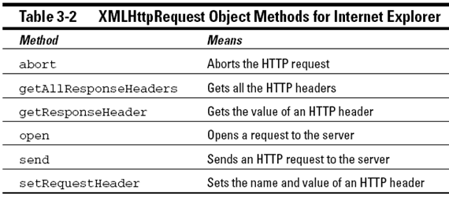
XMLHttpRequest – (XHR) Object

Slide 17
HTTP Status Codes
The first line of the HTTP response is called the status line
The way the user agent handles the response primarily depends on the code and secondarily on the response headers.
Success: 2xx
Redirection: 3xx
Client-Side Error: 4xx
Server-Side Error: 5xx

Slide 18
XMLHttpRequest - onreadystatechange
During an Ajax operation, the server sends updates to the client about the current status of the communication
This is done by updating a property of the XMLHttpRequest object
The property is called readyState
Therefore every time the readyState property is changed, readystatechange event is triggered
If a function is attached to the onreadystatechange event handler, the function will be executed every time the server pings the client with an update

Slide 19
XMLHttpRequest – readyState values
State | Description
0 | Uninitialized
1 | Loading
2 | Loaded
3 | Interactive
4 | Complete

Slide 20
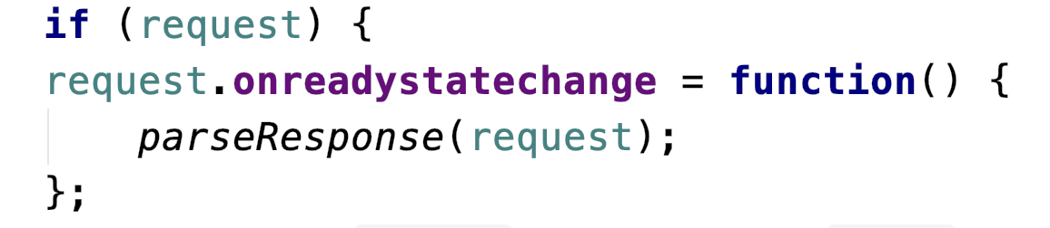
XMLHttpRequest - onreadystatechange

Slide 21
XMLHttpRequest - open
When a Web browser asks for a resource (e.g. web page) from a Web server, it issues a request
It specifies the location of the file on the server
The request may also include more information, such as data inputted through a form
The browser also specifies how the request is sent to the server. this is usually a GET request or a POST (when a lot of data is being sent)
The open method of the XMLHttpRequest replicates this kind of transaction in an Ajax call

Slide 22
XMLHttpRequest - open
Method
The first argument of the open method is a string such as “GET” or “POST”
Other methods include PUT, DELETE and HEAD
If you want to send data to the server use POST
GET should never be used to send requests that will update something on the server
URL
The second argument of the open method is a string that contains a path to the file on the server that you want to request

Slide 23
XMLHttpRequest - open
Asynchronous
As well as the two required parameters, request method and URL, the open method also accepts some optional arguments.
A boolean value of true or false as a third argument specifies if the request should be sent asynchronously or not. It the parameter is set to true, then the processing of the script will not stop waiting for a response from the server

Slide 24

XMLHttpRequest - open
Username and Password
Two other optional arguments may be included in the open method, which are user name and password

Slide 25
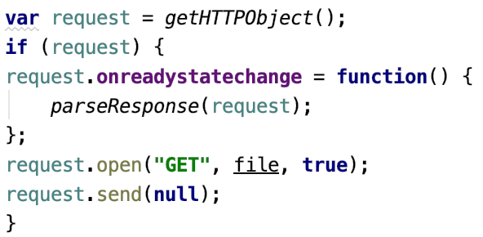
XMLHttpRequest - send
The open method specifies the details of an Ajax request, but it doesn’t initiate the request
The send method initiates the request

Slide 26
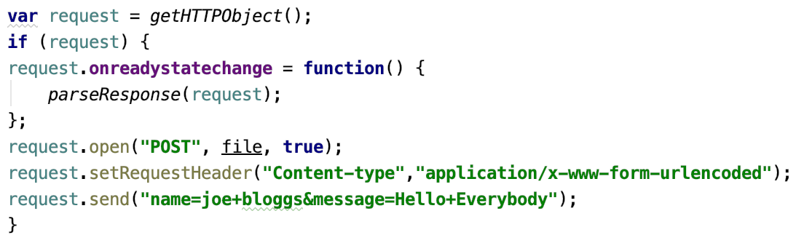
XMLHttpRequest – send with POST
When data is sent with the POST method, the data must be sent as a query string i.e. name – value pairs joined by ampersands and URL encoded. This means spaces become plus signs and non-alphanumeric characters as hex values

Slide 27
XMLHttpRequest – receiving a response
The readyState property indicates the current state of an Ajax request
Its value is numerical
  0 Unitialized. The open method hasn’t been called
  Loading. The open method has been called, but the send method hasn’t
  Loaded. The send method has been called. The request has begun
  Interactive. The server is in the process of sending a response
  Complete. The server has finished sending a response

Slide 28
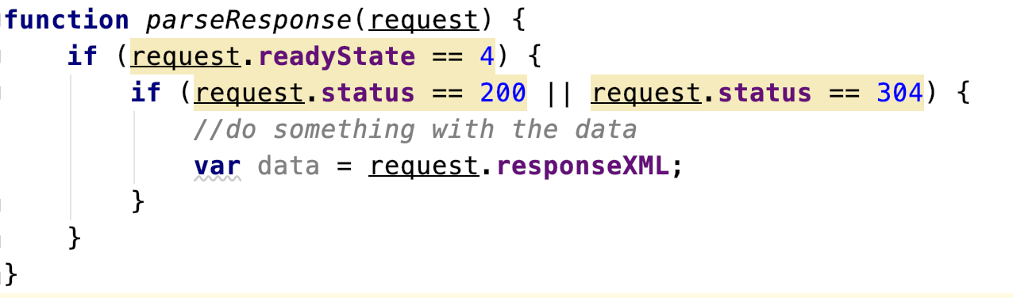
XMLHttpRequest – receiving a response
Every time the value of readyState changes, the readystatechange event is triggered
Must check readyState to see if completed
responseText or responseXML is the property that contains the data.

Slide 29
XMLHttpRequest – response status
In the same way that a Web browser sends headers with each request it makes, a Web server sends headers with each response it sends
These headers contain information about the server, as well as information about the document being served
The most important header sent with any response from a Web server is the status code
Examples
  404 “Not Found”
  500 “Internal Server error”
  “OK”
  304 “Not Modified”

Slide 30
AJAX Page Lifecycle - Summary
Browser makes an HTTP request for a URL
Server returns initial HTML page
Browser renders the page as an in-memory DOM tree
User activity causes asynchronous requests to other URLs
Browser returns data to JavaScript callback functions in the page
JavaScript callback functions update the DOM in memory
Browser redraws the relevant part of the page without a full page refresh

Slide 31
Data Formats
AJAX is language agnostic on the server side
However the data from the server must be formatted in a way that the browser can understand
Data can be returned as:
  HTML
  XML
  JSON

Slide 32
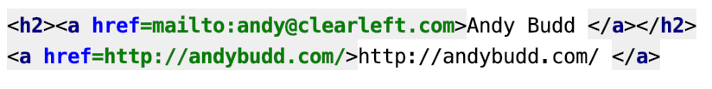

Data Formats - HTML
For a contact details page, data could be sent back like:
The HTML snippet could returned as given
HTML consists of plain text and will be available in the responseText property

Slide 33
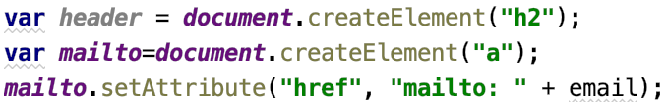
Data Formats – HTML Generating Content
Using DOM methods to generate the following HTML
To create the text node that goes inside the link

Slide 34
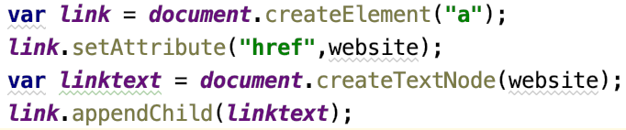
Data Formats – HTML Generating Content
To output the website value

Slide 35
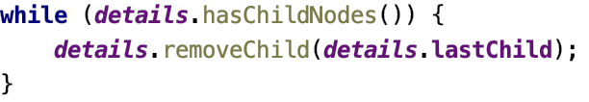

Data Formats – HTML Generating Content
To insert the Markup into the div with the ID details:
To ensure that the container div element is empty:-
To insert the new Markup

Slide 36
Data Formats - HTML
HTML –Advantages
Saves on parsing data from server
Readable data format and familiar to developers
HTML –Disadvantages
Doesn’t work so well if you want to update multiple parts of a document

Slide 37
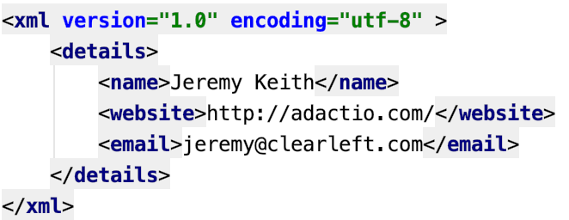
Data Formats - XML
XML was created as a means of storing data
Example of an XML document that stores contact details

Slide 38
Data Formats – XML Extracting Data
Each person in a list is linked to the XML file with that person’s contact details
The XML file can be parsed using JavaScript
The XML is available through the responseXML property of the HTTPRequest object
Use getElementsByTagName to get a collection of all the name elements in the XML:

Slide 39

Data Formats – XML Extracting Data
There is only one name element in the file
The name element contains the text node and we need to find the value of the text node
The same DOM methods and properties can be used to retrieve the values in the website and email elements

Slide 40
Data Formats – XML Advantages
XML is a versatile data format
XML is one of the most common means of transferring data within Web apps
XML can be parsed with DOM Scripting
XML can be validated against a Schema specification

Slide 41
Data Formats – XML Disadvantages
XML sent from server must have correct header or will not be available via the responseXML
Parsing on the browser can become long-winded for complex applications

Slide 42
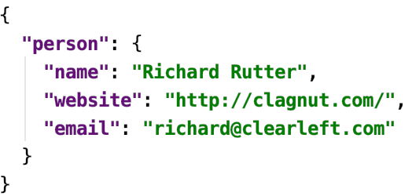
Data Formats – JSON
JSON stands for JavaScript Object Notation
A person object in JavaScript

Slide 43
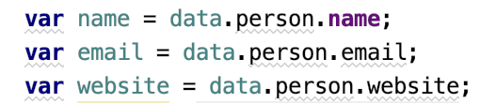
Data Formats – JSON Extracting Data
JSON is a string of text and is returned in the responseText property
JavaScripts eval function accepts a string as an argument. The string is then executed as JavaScript code
now all JSON values can be accessed as properties of data:

Slide 44
Data Formats – JSON Extracting Data
If the JSON in the response text is properly formed:
    conforms to the JSON Specification.
    Keys need to be in double quotes.!!
You can use the alternative JSON.parse() method instead.
again all JSON values can be accessed directly properties of data:

Slide 45
Data Formats - JSON
JSON – Advantages
JSON is more lightweight than XML
JSON doesn’t need to be sent from the server with a specific header. It can be sent as plain text
Easier to parse and manipulate in JavaScript
Can be validated via 3rd party libraries
Parsing using JSON.parse() safer than eval()
JSON – Disadvantages
JSON syntax is very precise
Parsing with eval method can be a security risk

Slide 46
Data Formats – JSON Summary
JSON provides an easy way to create and store data structures for use with JavaScript
Data encoded with JSON can be read into a variable which creates an object
Becoming the de-facto format for RIA’s
https://www.json.org/json-en.html

Slide 47
Alternatives to using XHR directly
Frameworks such as backbone.js
jQuery (separate lecture)
The fetch API with promises (separate lecture)

